Slide 1
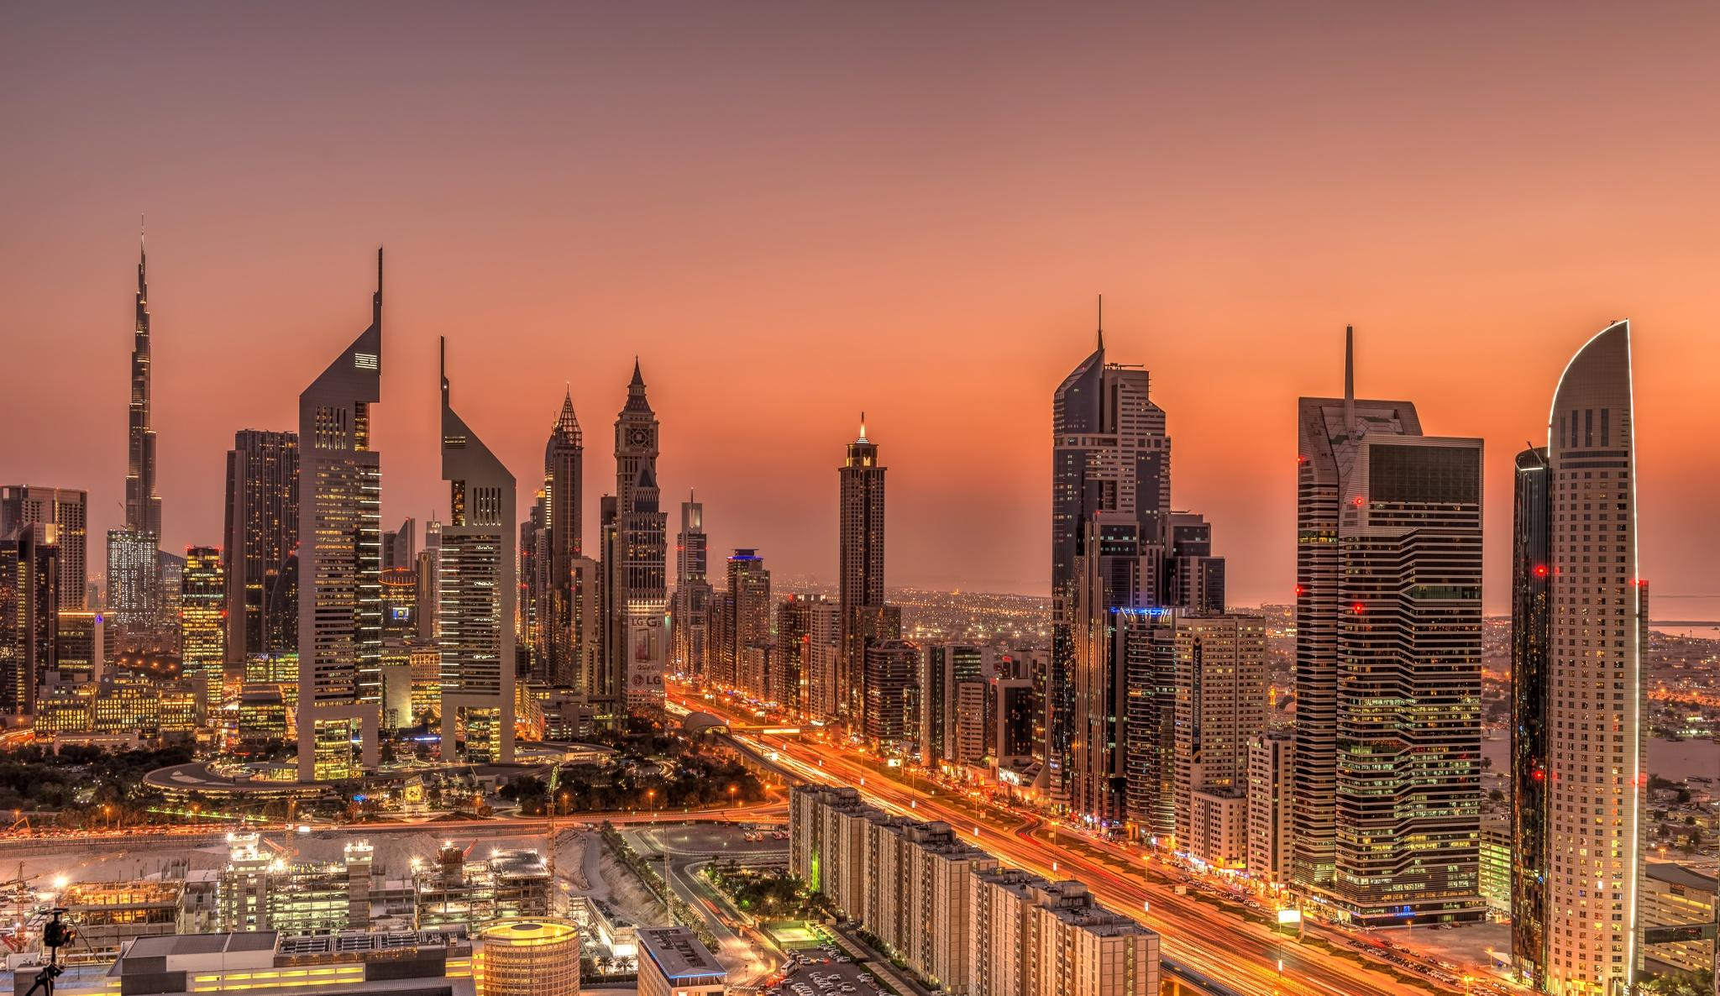
MEET ME
MEET ME
BY
TURINGGEEKS
POST MORTEM
TURINGEEKS

Slide 2


IMPLEMENTATION VS REQUIREMENTS
Draw from multiple calendar and scheduling systems
It should respect privacy and security preferences
It should work for users who do not use the same
calendaring application
It should draw from Google Calendar

Slide 3

Support complex attendance requirements
Distinguish between preferred meeting times and possible
meetings times
Handle time zones appropriately and robustly

Slide 4
IMPLEMENTATION VS PROCESS REQUIREMENTS
Use a modern web framework to implement client interface
Project artifacts should be hosted on a public repository
User security and privacy issues are addressed
The project should be suitable for adoption and extension
by other developers

Slide 5
WILL WE DO AGILE AGAIN?
Improper time estimate for features early in the process (Outlook calendar import)
Mistook agile for lack of a process model. Got clarity only after sprint 2!
Sprint planning meetings and daily stand up meetings really helped us to get our focus in the right place and quickly adapt to changes.
Prioritizing tasks was tough due to dependencies in user stories.

Slide 6
MEET ME
Thank you!
Questions?
TURINGEEKS

